Slide 1
Predictive Intelligence
AI/ML Use Case in ServiceNow
Prepared by - Yogesh Patel Yogesh Kale

Slide 2
Introduction
AI/ML Use Case in ServiceNow
Predictive Intelligence, formerly known as Agent Intelligence, is a ServiceNow platform capability that operationalizes machine learning solutions within your existing processes without the need for an army of data scientists to build custom solutions.
Predictive Intelligence is not a standalone product - it’s a layer of artificial intelligence features and capabilities that can be applied across ServiceNow applications.

Slide 3


Personas & Roles
AI/ML Use Case in ServiceNow
Application Administrator
Report User
[ ml_admin ]
[ ml_report_user ]

Slide 4
Benefits of PI
AI/ML Use Case in ServiceNow
Deliver and refine AI quickly
Work faster and smarter
Improve efficiency and customer satisfaction
Decrease resolution times and manual errors

Slide 5
Features Available
AI/ML Use Case in ServiceNow
Predictive Intelligence Workbench
Major Incident Detection
Action and Content Recommendations
Categorisation, Routing, and Prioritisation

Slide 6


How is PI Useful?
AI/ML Use Case in ServiceNow
End User
Front-Line Worker
Service Owners

Slide 7
Plugins
AI/ML Use Case in ServiceNow
Predictive Intelligence ( com.glide.platform_ml )
Predictive Intelligence Enhanced UI( com.glide.platform_ml_ui )
Predictive Intelligence For Contextual Search (com.snc.contextual_search_ml )
Predictive Intelligence Reports ( com.glide.platform_ml_pa )
Predictive Intelligence For Customer Service Management (com.snc.csm_ml )
Predictive Intelligence For Ideation (com.snc.innovation_management_ml )
Predictive Intelligence For Knowledge Management (com.snc.knowledge_ml )

Slide 8
PI Frameworks
AI/ML Use Case in ServiceNow
Predictive Intelligence provides four frameworks that you can use to create machine-learning solutions in your instance.
Each framework delivers a different solution type for training the system to predict, recommend, and organize data outcomes.
Predictive Intelligence is included in these packages:
ITSM Professional, CSM Professional, HR Professional, HR Enterprise, and Now Platform App Engine Professional

Slide 9
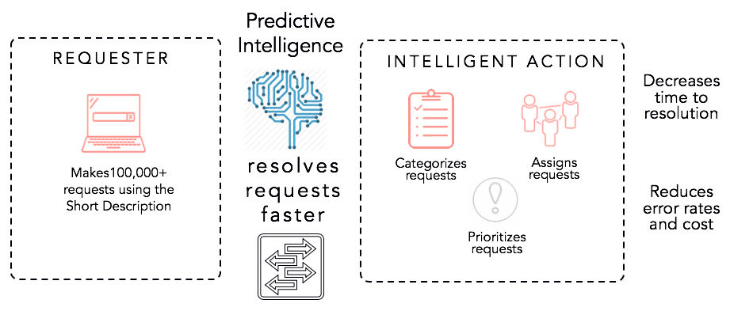
PI Classification Framework
AI/ML Use Case in ServiceNow
The PI classification framework enables you to use machine-learning algorithms to set field values during record creation, such as setting the incident category based on the short description.

Slide 10
PI Regression Framework
AI/ML Use Case in ServiceNow
Regression is a machine-learning framework that you can train with historic data to predict numeric outputs, such as a temperature or a stock price.
For example, you can use regression to estimate the time it takes to resolve an incident or a case.

Slide 11
PI Clustering Framework
AI/ML Use Case in ServiceNow
Group similar records into clusters so you can address them collectively or identify patterns.
For example, you can group similar incidents that have occurred recently to identify a major incident.

Slide 12
PI Similarity Framework
AI/ML Use Case in ServiceNow
The Predictive Intelligence similarity framework identifies existing records that have similar values to a new record.
You use the framework to build a word corpus.
The word corpus functions as the vocabulary the system uses to compare your trained records based on their textual similarity.

Slide 13
Disadvantages
AI/ML Use Case in ServiceNow
To train a Predictive Intelligence framework we need at least of 10,000 records. (The recommended number of records to train is 30k).
There shouldn’t be any empty or missing data fields in the training records. The quality of data is also important.

Slide 14
Thank You
AI/ML Use Case in ServiceNow

